Slide 1
EP Global Opportunities Trust plc
Investment Update April 2021

Slide 2
Periodic Performance (%)
Performance
 | 2020 | Since Inception*
Share Price | -5.6 | 7.9
NAV | -1.3 | 8.5
Index | 13.0 | 10.4
*Inception 15 Dec 2003.
Share Price and FTSE All World Index total returns are sourced from Datastream from Refinitiv. Share price returns are calculated on a closing mid price basis. NAV returns, including current period income, are sourced from Edinburgh Partners. All dividends are reinvested at the ex-dividend date.
Discreet Performance up to the end of March 2021 is available at the end of the presentation
Past performance is not a guide to future performance.
Source: Edinburgh Partners 31 Dec 20

Slide 3
Market Commentary 2020
At the beginning of 2020 we felt that markets were underpinned not by valuation but by the promise of fiscal and monetary policy support
This support stemmed partly from the forthcoming US election and partly because of a gradual evolution since the GFC where the ‘authorities were underwriting asset values’
One would have thought that the unprecedented rise in debt levels caused by the pandemic - on top of an already elevated level - might have given asset markets some pause for thought
The out-turn was proof that the history of government support has temporarily vaccinated markets against most forms of disturbance
The main question now is: how long can interest rates be determined by government action rather than the market?

Slide 4
Covid Hit Stocks: 2020
Bottom 10 Contributions by Stock
Source: Edinburgh Partners Global Opportunities Trust plc, as at 31 Dec 20

Slide 5
Tech Heroes: 2020
Absolute Contributions for 12 months to December 2020 Performance %
Source: Edinburgh Partners Global Opportunities Trust plc, as at 31 Dec 20

Slide 6
Liquidity Continues to Rise, Tech Reduced
Industrial Analysis of Assets (%)
Source: Edinburgh Partners Global Opportunities Trust plc, as at 31 Mar 21

Slide 7
US the Biggest Market, also the Most Expensive
Geographical Analysis of Assets (%)
Source: Edinburgh Partners Global Opportunities Trust plc, as at 31 Mar 21

Slide 8
Portfolio Valuation Highest Since Inception
Source: Edinburgh Partners Global Opportunities Trust plc, as at 31 Dec 20

Slide 9
Outlook for 2021
The starting point is that, at best, asset markets are fully valued on almost all historic metrics, unless one believes that interest rate suppression is now a permanently embedded feature of the global economy
The consequence is that markets have risen on the back of an economy underpinned by debt. This has now reached levels that would previously have caused concerns over stability and a need to show markets an exit path
However, far from pushing for an exit path, markets are demanding ever more support. This seems to be the premise upon which markets are now operating; with the pressures of relative performance pushing most participants into some form of acquiescence rather than observation of valuation considerations
Our portfolio therefore remains defensive and focused on companies in which we have a degree of confidence in their earnings prospects and the valuations are still reasonable
We are not finding significant value in the cyclical sectors, and the growth areas have been overvalued for some considerable time
Where we identify market dislocations and opportunities present themselves, we will continue to initiate positions as we did during the market shock last year, but this will remain contingent upon valuation

Slide 10
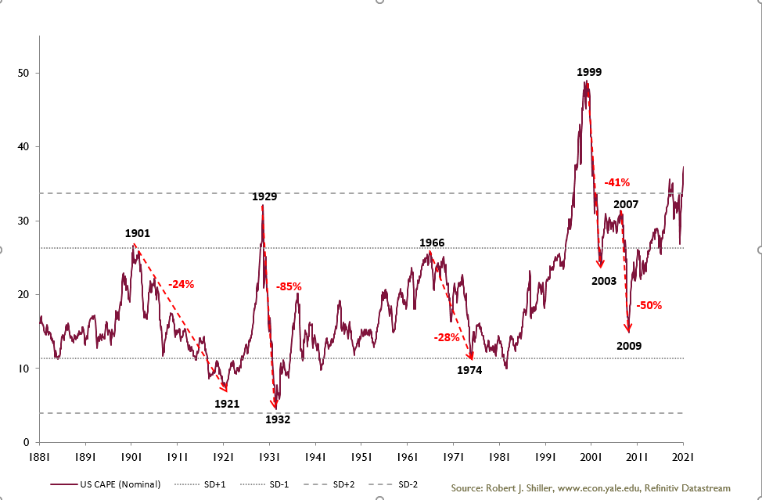
US CAPE Second Highest in History

Slide 11
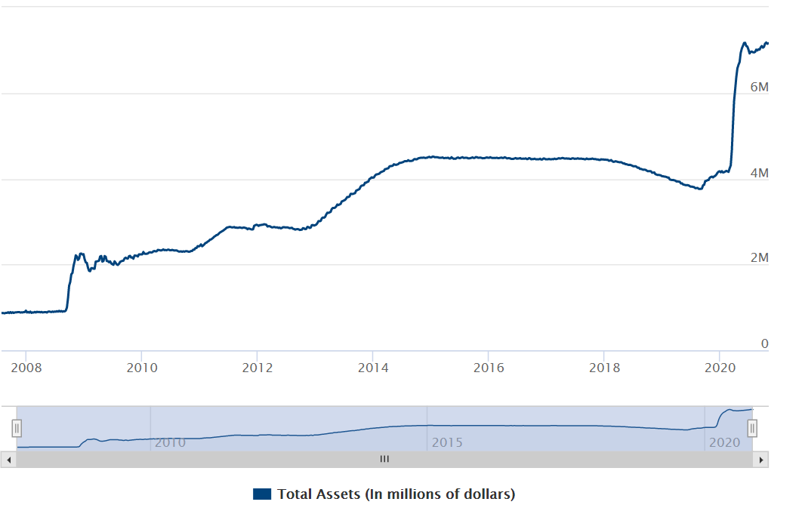
The Fed ‘Put’ Getting More Expensive

Slide 12
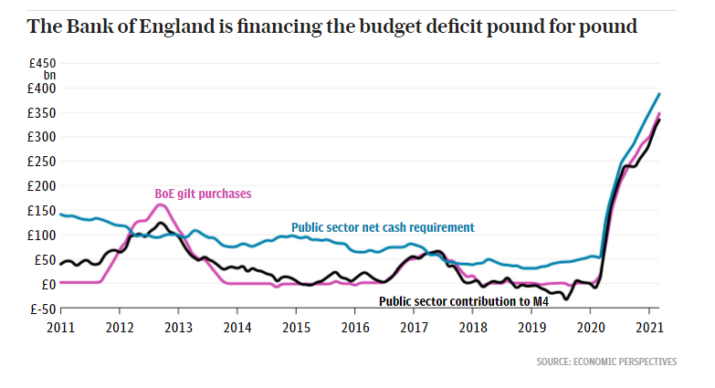
So is the BoE ‘Put’

Slide 13
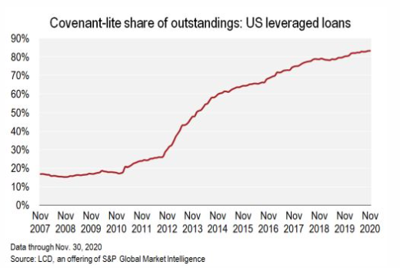
Low Interest Rates = Higher Leverage

Slide 14
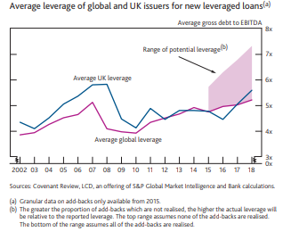
Lower Interest Rates = Less Earnings Coverage

Slide 15
Low Interest Rates = More Speculative Instruments

Slide 16
Lack of Confidence in Currencies = Crypto

Slide 17
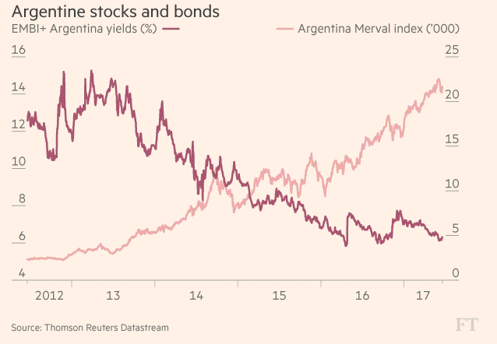
Already Seen Boom

Slide 18
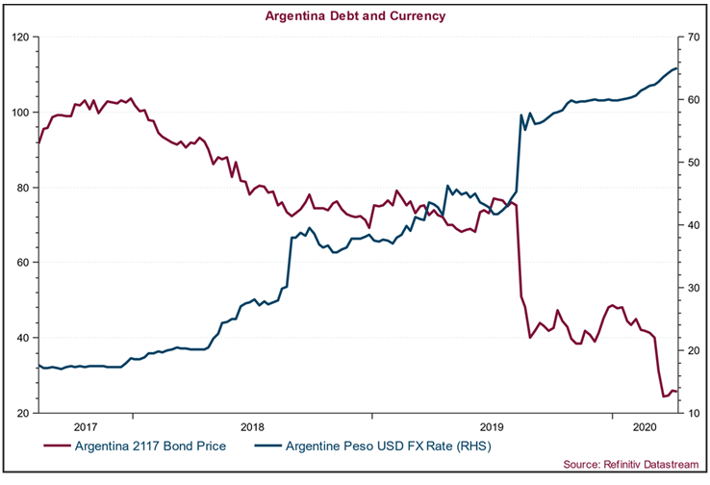
Followed by Bust

Slide 19
Signs of Excess: to Summarise
Record lows on interest rates
Record government debt
Record debt held by central banks
Conventional wisdom on policy now tilted toward intervention both monetary and fiscal
Increased leverage
Lower quality debt
Signs of speculation and excess

Slide 20
Where Does This Lead Us
As always timing is impossible
The signs of excess are all around us after 10+ years of suppressed interest rates and rising asset prices
The valuation levels are entirely dependent upon:
Interest rates
Confidence
Economic underpinning
All of these are vulnerable

Slide 21
There Will be a Time to Become Excited
Liquidity will be maintained and may even grow until assets are undervalued
Patience is required
The alternative is to assume one can buy expensive stocks and sell them to someone else before anything goes wrong
Confidence will crack and liquidity will evaporate
If assets are the most expensive in modern history then the decline will not be gentle but the opportunities will be widespread for those able to take advantage

Slide 22
Periodic Performance (%)
Discrete Performance
 | 31 Mar 20 31 Mar 21 | 31 Mar 19 31 Mar 20 | 31 Mar 18 31 Mar 19 | 31 Mar 17 31 Mar 18 | 31 Mar 16 31 Mar 17
Share Price | 24.2 | -21.5 | 8.3 | 0.3 | 30.6
NAV | 14.9 | -13.6 | 3.5 | 4.2 | 32.4
Index | 39.6 | -6.2 | 10.7 | 2.9 | 33.1
Share Price and FTSE All World Index total returns are sourced from Datastream from Refinitiv. Share price returns are calculated on a closing mid price basis. NAV returns, including current period income, are sourced from Edinburgh Partners. All dividends are reinvested at the ex-dividend date.
Past performance is not a guide to future performance.
Source: Edinburgh Partners 31 Mar 21

Slide 23
Most Notable Transactions in Quarter 3 & 4 2020 - Buys
The Company is listed on the London Stock Exchange. As a result the value of the shares and any income derived from them can fall as well as rise, and investors may not get back the full value of their investment. As the Company invests in overseas securities, fluctuations in exchange rates may also cause the value of the shares (and any income from them) to fall as well as rise.
This recording does not constitute, and is not subject to the protections afforded to, independent research. Edinburgh Partners and its staff may have dealt in the investments concerned.
The views expressed are those of the speakers, should not be considered as advice or a recommendation to buy, sell or hold a particular investment. No reliance should be placed on these views when making investment decisions.
Past performance is not a guide to future performance.
Edinburgh Partners Limited is authorised and regulated by the Financial Conduct Authority (FCA). The investment trust managed by Edinburgh Partners Ltd are listed UK companies. Edinburgh Partners Global Opportunities Trust plc is listed on the London Stock Exchange and is not authorised or regulated by the FCA. Edinburgh Partners AIFM Ltd (registered in Scotland SC460631) is wholly owned by Edinburgh Partners Limited and is the Alternative Investment Fund Manager to Alternative Investment Funds.
A Key Information Document for the Company is available by visiting www.epgot.com.

Slide 24
EP Global Opportunities Trust plc

